Slide 1
An Intro to F# For The C# Developer
Part 1
This presentation has ben adapted from a presentation by
Mathias Brandewinder to the San Francisco F# Users Group
I am not a cat person so I have replaces his cute kitten photos with
Labrador Retrievers

Slide 2
Where to start?
Can’t teach a language in one hour
It has been said that it takes about a year to integrate functional programming paradigms into your thinking
C# has been introducing many Functional constructs so you already know some of this
While it takes a year to become an expert, you can usefully use F# with just a few days of study as it includes many object – oriented constructs
I get the same questions all the time
Why should I use F#?
Where should I use F#?

Slide 3
The plan: take a stroll
Highlight differences between F# and C#
Show areas where F# is awesome
Give you a sense for core syntax / ideas
Give you a sense for the “coding rhythm”
Avoid all-out hardcore functional stuff
For the record: I DO like C#. I just love F# ☺

Slide 4

Hello, F#!

Slide 5
What did we see?
Lightweight syntax
Type inference
Smooth interop with C#
FSI (F# Interactive), the REPL
Record Type

Slide 6

C# and F#, happy together

Slide 7

Units of Measure

Slide 8
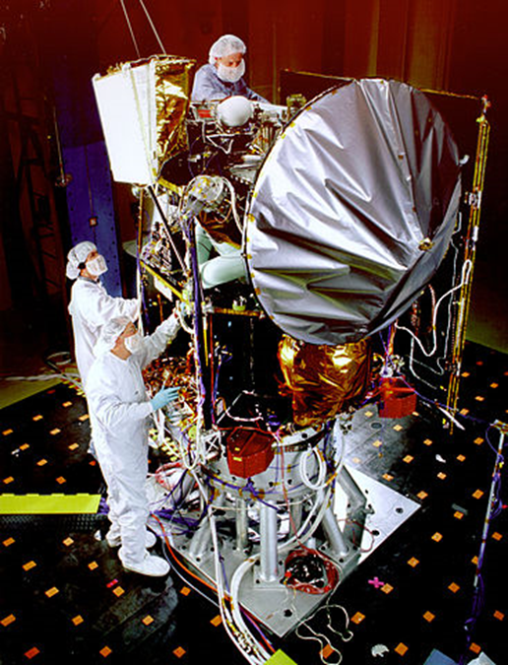
NASA Mars Climate Orbiter: oops!
… on September 23, 1999, communication with the spacecraft was lost as the spacecraft went into orbital insertion, due to ground based computer software which produced output in non-SI units of pound-seconds (lbf×s) instead of the metric units of newton-seconds (N×s) specified in the contract between NASA and Lockheed. The spacecraft encountered Mars at an improperly low altitude, causing it to incorrectly enter the upper atmosphere and disintegrate.

Slide 9
What did we see?
Units of Measure allow safer code

Slide 10

Discriminated Unions

Slide 11
What did we see?
Discriminated Unions define “Cases”
Discriminated Unions enforce code consistency
Discriminated Unions are an “enum on steroids”
Discriminated Unions can be Pattern Matched
Discriminated Unions enable simple and powerful domain models

Slide 12

The Curse of Null

Slide 13
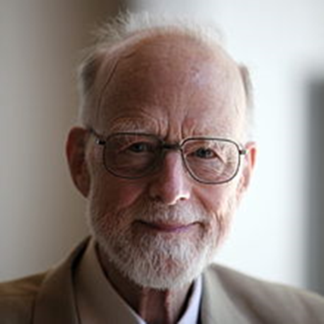
Tony Hoare
Speaking at a conference in 2009, Hoare apologized for inventing the null reference:
I call it my billion-dollar mistake.
It was the invention of the null reference in 1965. At that time, I was designing the first comprehensive type system for references in an object oriented language (ALGOL W). My goal was to ensure that all use of references should be absolutely safe, with checking performed automatically by the compiler. But I couldn't resist the temptation to put in a null reference, simply because it was so easy to implement.
This has led to innumerable errors, vulnerabilities, and system crashes, which have probably caused a billion dollars of pain and damage in the last forty years.

Slide 14
No Nulls Allowed
Current Estimates of the cost of using nulls is approximately 1 Billion $ a year
From Don Syme’s Blog
“this comparison records that one C# project had 3036 explicit null checks, where a functionally similar F# project had 27, a reduction of 112x in the total number of null checks. The other statistics in the comparison shown are also compelling, particularly the “defects since go live”. The two statistics are not unrelated.
After a recent F# meet up I grilled one of the guys who wrote this comparison to learn more about it. I can confirm that they are not making these stats up: these projects are both ETL (Extract, Transform, Load) systems which are broadly speaking in the same zone in terms of functionality, or if anything the F# implements more features. The F# project really did have a very, very low bug rate. The size difference is not due only to language differences; there are also differences in design methodology, with the C# characterized by the overuse of OO design patterns that is often seen in C# and Java projects.”

Slide 15
What did we see?
Option type is a better Null Object pattern
F# avoids nulls
Pattern matching allows “matching data against shapes”

Slide 16

Functions

Slide 17
What did we see?
Functions are first-class citizens in F#
Function signature is all you need
“inside-out” programming
Functions are composable
Pipe-forward
Declarative List syntax

Slide 18

Type Providers

Slide 19
What did we see?
Type Providers give intellisense over untyped external resources
Type Providers help data-rich programming
Less infrastructure to get the data
Intellisense gives discoverability
Type Providers available for
Csv, OData, JSON, SQL, XML, XAML, WorldBank, FreeBase,
WMI, Hadoop/Hive, R, TypeScript, WSDL, EntityFramework
PostGis, Excel, Twitter, …
If it doesn’t exist you can build it

Slide 20

Conclusion
A language that doesn’t affect the way you think about programming, is not worth knowing. — Alan Perlis, Epigrams on Programming

Slide 21
Take aways
F# is a low noise, high power language
F# is both Functional and Object Oriented
F# is a very robust language
Used in banking, stock transactions, scientific computing
REPL is rad, great for fast prototyping
Type Providers enable data rich programming

Slide 22
… and there is more
I left out quite a bit
Immutability
Sequences, laziness
Computation Expressions
Object expressions
DSLs, Code Quotations
Async
inlining
…

Slide 23
Where does F# fit?
You care about correct code
You need to explore data / prototype
You are building a workflow
Your code uses LINQ & Funcs a lot
You need Cross Platform development
Supports Windows, Linux, Android …
Virtually anywhere, but…
Tooling is not as good as C# (But getting better quickly)

Slide 24

How do I start?

Slide 25
Online Resources
TryFSharp.org
FSharp.org
F# Koans on GitHub

Slide 26
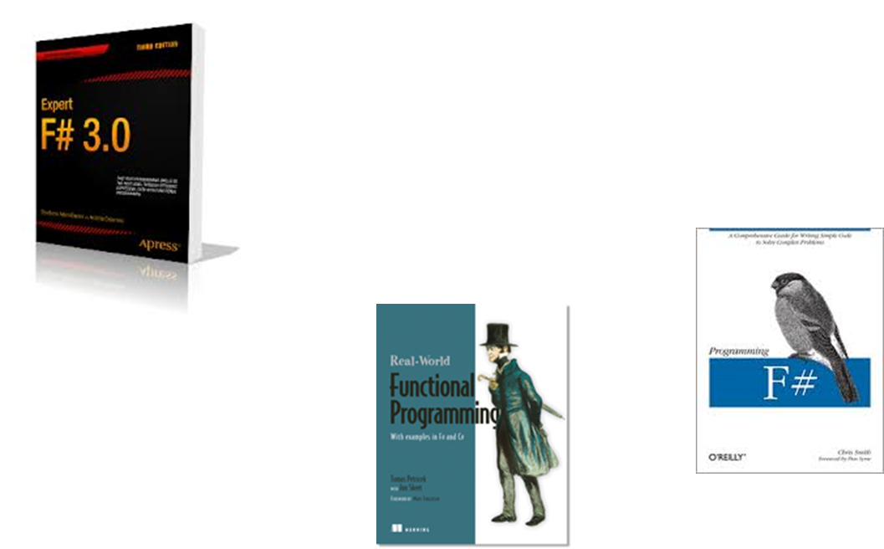
Books

Slide 27
Start small & safe
Don’t rewrite everything in F#!
Try out writing unit tests in F#
FsUnit, Foq
Try writing small dlls in F#
Write a public API using classes

Slide 28
Very active community
Don Syme’s blog
F# Weekly (sergey tihon)
#fsharp on Twitter
StackOverflow
Strong OSS community
GitHub, CodePlex
Compiler is on GitHub
SFSharp.org

Slide 29
What are developers saying?
“…writing C# feels like completing government forms in triplicate.” – Phillip Trelford
“C# has been becoming more of a functional language with virtually every new release and I’ve been using many of those capabilities for a few years but the language is hardly built around them.” – Dave Fancher
“Using F# now is like using the C# we will have in 3 years.” – David Thayer

Slide 30


Thank you - time for COOKIES?

